Slide 1


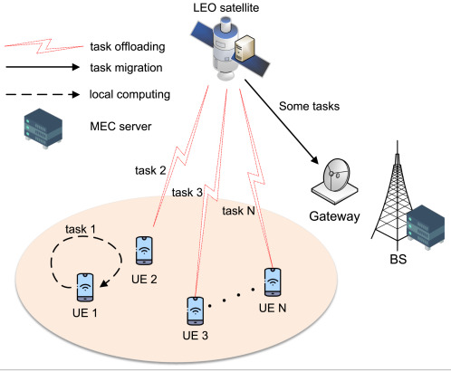
Satellite Internet Communication Using OSI Layers
CSA0711-Computer Networks
Name of the student :
T. Subahan (192511121)
GUIDED BY:
DR. R. Shankar

Slide 2


Introduction
Satellite Internet is a wireless communication technology that provides internet access using satellites orbiting the Earth instead of traditional fiber optic cables or mobile towers.
It is Mainly Used in:
Remote villages
Mountains
Oceans
Aircraft
The Open Systems Interconnection (OSI) model is a seven-layer networking framework that explains how data is transmitted across a network. In satellite communication, each OSI layer performs a specific function

Slide 3
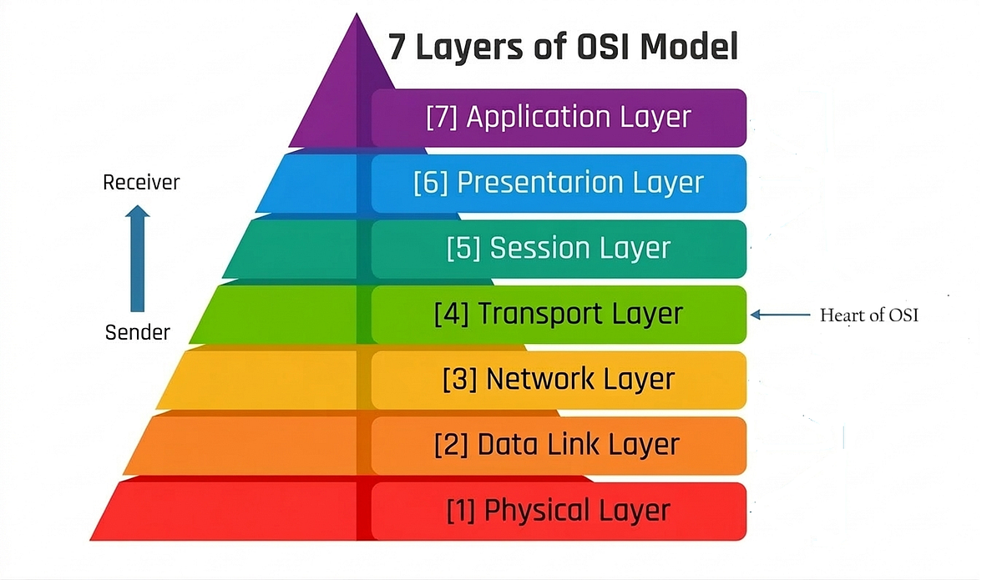
Working
The working of satellite internet communication can be understood by following how data travels through each of the seven OSI layers from the user's device to the satellite and finally to the internet server.
1. Application Layer (Layer 7):
The user opens a web browser or any internet application (e.g., Chrome, YouTube, Email).
The application generates a request, such as opening a website.

Slide 4
2. Presentation Layer (Layer 6):
The data is prepared for transmission.
It performs:
Data formatting
Encryption (for security)
Compression (to reduce data size)
3. Session Layer (Layer 5):
Establishes and manages the communication session between the user's device and the server.
4. Transport Layer (Layer 4):
Divides the data into smaller segments.
Handles:
Error recovery
Flow control

Slide 5
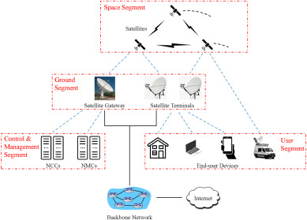
5. Network Layer (Layer 3)
Adds the source and destination IP addresses.
Determines the best path for the data to travel.
6. Data Link Layer (Layer 2)
Converts packets into frames.
Adds MAC addresses.
7. Physical Layer (Layer 1)
Converts digital data into radio frequency (RF) signals.
The satellite receives, amplifies, and retransmits the signals to the ground station.
The ground station forwards the data to the internet.

Slide 6
Advantages
Provides internet access in remote and rural areas where traditional networks are unavailable.
The OSI model ensures reliable, organized, and efficient data communication.
Makes network troubleshooting easier by identifying issues at specific OSI layers.
Supports secure, error-free, and standardized communication between different devices and networks.

Slide 7
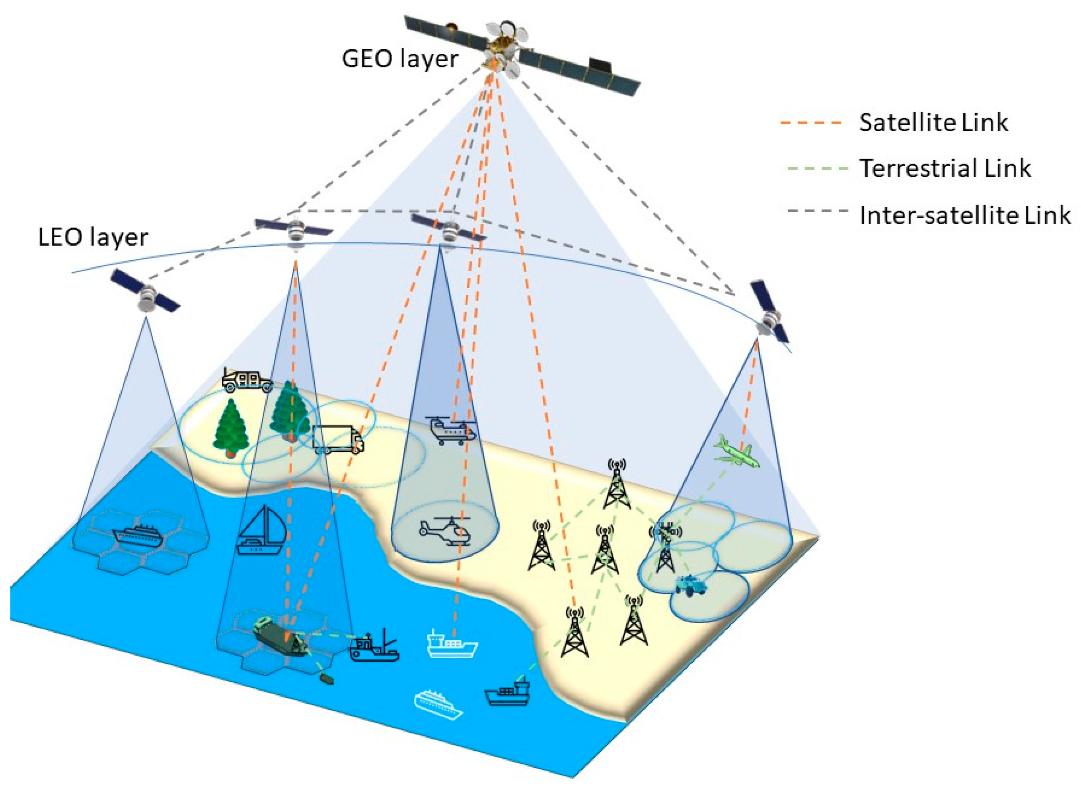
Applications
Used by the military and defense for secure communication and surveillance.
Supports weather forecasting and environmental monitoring through satellite data transmission.
Provides internet connectivity for oil rigs, mining sites, and offshore industries.
Enables live TV broadcasting, satellite phone services, and global navigation systems (GPS).

Slide 8
conclusion
Satellite Internet Communication using the OSI Layers provides a structured and reliable way to transmit data across satellite networks. It enables seamless internet connectivity even in remote and disaster-affected areas. Overall, it plays a vital role in delivering fast, secure, and dependable global communication.

Slide 9


